Slide 1




















































Azure Resource Manager (ARM) Overview

Slide 2


















































Azure Resource Manager (ARM) Overview

Slide 3











































Azure Resource Manager (ARM) Overview

Slide 4















































ARM Template Basics

Slide 5








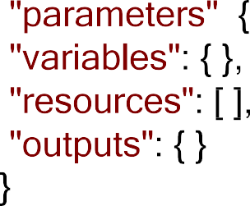
ARM Template Basic Format

Slide 6



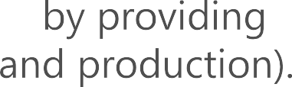
























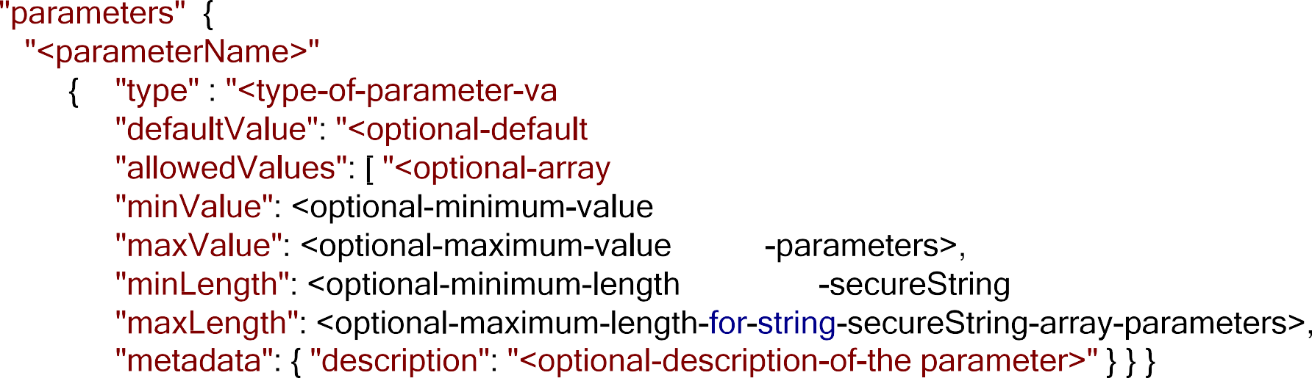











ARM Template Parameter Basic Format

Slide 7













































Plant Your Template

Slide 8






























Ways to deploy ARM Template

Slide 9



































































ARM Template Authoring Best Practice
Visual Studio and VS Code are the best authoring tools for ARM Template!

Slide 10






















































Known Issues/Limitations

Slide 11






































ARM Template Troubleshooting Tips

Slide 12






























Useful Resources & References

